Slide 1
Sql capstone - 2
A.Sai Akhilesh

Slide 2
Q1: What is user defined stored procedure and user defined function, explain and write the
differences?
Ans User defined stored function is function stores the query if a query is used day by day or instead of writing queries repeatedly then we stores the query and use it for our usage is called user defined stored procedure.
User defined function is a function provided by the user of a query,in a context where the usual assumption is that functions are built into the query. UDFs are usually written for the requirement of its user.
UDF can be used in the SQL statements anywhere in the WHERE/HAVING/SELECT section where as Stored procedures cannot be.
Procedure can return zero or n values whereas function can return one value which is mandatory.
Functions can be called from procedure whereas procedures cannot be called from function.
Procedure stores the query and function can’t stores the query.
Function can take time to complete and execute compared procedure because it is already stores the query.

Slide 3
Q2: what are advantage of using stored procedure?
Ans: Stored procedure is faster when compared to function.
Stored procedure is pre-compiled.
Stored procedure is reduces network traffic.
Stored procedure is reusable.
Security is high in store procedure.
The executable code is automatically cached, hence lowers the memory space.

Slide 4
Q3: what is your understanding with complex stored procedure explain with example.
Ans: A complex store procedure is a procedure has a complex syntax and comprise the multiple parts .A complex query can include several joins between the tables or have queries or a query is nested within another query of stored procedure.
CREATE PROCEDURE
insert_data
@College_ID char(5),
@First_name varchar(30),
@Last_name varchar(30),
@Stream varchar(25),
@Email varchar(30),
@Phone int(14)
AS INSERT INTO Student ([College ID], [First Name], [Last Name], Stream, [E mail], Phone)
VALUES (@College_ID ,@First_name ,@Last_name ,@Stream, @Email, @Phone)
GO
And have the same query in another procedure then that procedure is called complex
stored procedure.

Slide 5
Q4: what are system defined stored procedure , list any five and explain.
Ans: These stored procedures are already defined in SQL is called system defined store procedure These are physically stored in hidden SQL Database .This procedure starts with the sp_ prefix. Hence we don't use this prefix when naming user- defined procedures. Here we have a list of some system defined procedure.
sp_rename : –
It is used to rename the names of database object like stored procedure, views etc…
sp_changeowner : –
It is used to change the owner of a database object.
sp_help :-
It provides details on any database object.
sp_helpdb:-
It provides the details of the databases defined in the SQL Server.
sp_helptext :-
It provides the text of a stored procedure reside in SQL Server
sp_depends :-
It provides the details of all database objects that depend on the specific database object.

Slide 6
Q5: what type of triggers, and on what event you can pass trigger.
Ans: Triggers is a special type of stored procedure that is automatically executed when a DDL or DML command statement related to the trigger is executed. Triggers are used to assess data before or after data modification using DDL and DML statements.
DDL triggers- CREATE,ALTER,DROP.
DML triggers- INSERT,UPDATE,DELETE.

Slide 7
Q6: write about recursive trigger.
Ans: If a trigger modifies the same table where the trigger was already created, the trigger does not fire again unless the recursive triggers option is turned on. recursive triggers is a database option turned off by default.

Slide 8
Q7: Explain importance of indexes, on OLTP system and OLAP system.
Ans: Indexes are the special lookup tables that the DataBase search engine can use to speed up the data retrieval.
OLTP and OLAP are two terms look similar but refer to different kinds of systems. Online transaction processing (OLTP) captures, stores, and processes data from transactions in real time. Online analytical processing (OLAP) uses complex queries to analyze
aggregated historical data from OLTP systems.
* Indexes speed up the querying process by providing swift access to rows in the data tables.
* Indexes allow the database application to find data fast without reading the whole table.
* Indexes are used to retrieve data from the database more quickly than otherwise.

Slide 9
Q8: What is difference between rowstore and columnstore indexes.
Ans: Rowstore indexes with transactional workloads because they tend to require mostly table seeks instead of table scans.
Columnstore indexes give high performance gains for analytic queries that scan large amounts of data, especially on large tables.
All relational tables, unless you specify them as a clustered columnstore index, use rowstore as the underlying data format.
A nonclustered columnstore index to perform analysis in real time on an OLTP workload.

Slide 10
Q9: Write script of merge join and write the importance.
Ans: Merge join is used to join the different database and output is generated by joining two sorted datasets, output be single dataset.
Merge join operator supports all the joins like inner join,outer join,cross join,self join.
Merge statement in SQL is very popular caluse that can handle inserts,updates and delete statements.
When we want to retrieve data from more than one table then we use merge join.
FIRST TABLE
1
2
3
4
5
SECOND TABLE
1
1
2
2
3
OUTPUT
1
1
2
2
3

Slide 11
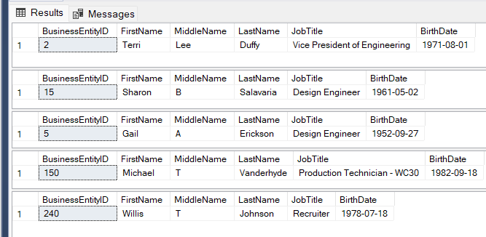
Q10: Write the script for following: (10*5=50)
a. create stored procedure which take input parameter as businessentityid, then in output, you receive the information of that person. Choose as many related columns for that businessentityid from database adventureworks)
Ans:
CREATE PROC Entity_details(@BussinessEntityID int)
AS
BEGIN
SELECT Person.Person.BusinessEntityID,FirstName,MiddleName,LastName,JobTitle,BirthDate
FROM HumanResources.Employee
INNER JOIN Person.Person
ON Person.Person.BusinessEntityID=HumanResources.Employee.BusinessEntityID
WHERE Person.Person.BusinessEntityID=@BussinessEntityID
END
EXEC Entity_details '2'
EXEC Entity_details '15'
EXEC Entity_details '5'
EXEC Entity_details '150'
EXEC Entity_details '240'

Slide 12
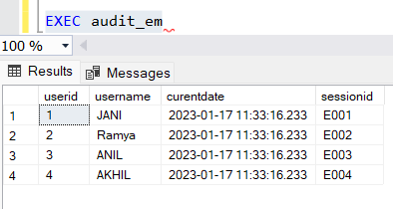
b. Create audit stored procedure where, whenever insert update or delete command is executed on employee table, then at same time audit table is also populated with those records, and userid,username,curentdate and time value, sessionid.
Ans CREATE TABLE Employee
( userid char(5),
username varchar(30),
curentdate datetime,
sessionid char(5)
)
INSERT INTO Employee
VALUES (1,'JANI',GETDATE(),'E001'),(2,'EANI',GETDATE(),'E002'),(3,'ANIL',GETDATE(),'E003'),
(4,'AKHIL',GETDATE(),'E004'),(5,'JAAN',GETDATE(),'E005')
UPDATE Employee
SET username='Ramya'
WHERE userid=2
DELETE Employee
WHERE userid=5
CREATE PROCEDURE audit_em
AS
BEGIN
SELECT * FROM Employee
END
EXEC audit_em

Slide 13
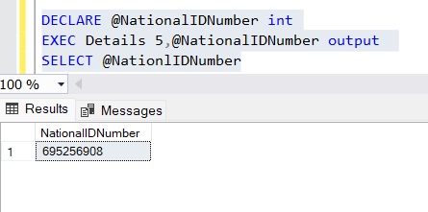
c. create stored procedure with input output and default parameter at same time, use any table, and parameters needed.
Ans
CREATE PROCEDURE Details(@BussinessEntityID int,@NationlIDNumber int OUTPUT)
AS BEGIN
SELECT @NationlIDNumber=NationalIDNumber FROM HumanResources.Employee
WHERE HumanResources.Employee.BusinessEntityID=@BussinessEntityID
END
DECLARE @NationalIDNumber int
EXEC Details 5,@NationalIDNumber output
SELECT @NationlIDNumber

Slide 14
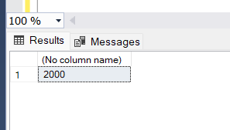
d. Create deterministic and non-deterministic user defined function, take any example.
Ans
CREATE FUNCTION DETERMINISTIC(@Var int)
RETURNS INT AS
BEGIN
RETURN @Var+1000
END
SELECT dbo.DETERMINISTIC (1000)
when we execute with the same var repetedly the output be same its doesn’t change it is called deterministic.
Nondeterministic functions result was different ouput eachtime they are called as fixed set of input values.For example GETDATE() function results the current date and time value,
always a different value.

Slide 15
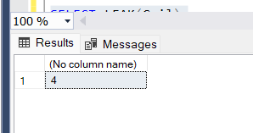
e. create user defined function so that if any column character length is checked then, user defined function gives output as length of characters for each row.
Ans
CREATE FUNCTION LEAK(@FirstName char(10))
RETURNS TABLE
AS
RETURN
SELECT
LEN(FirstName)
FROM Person.Person
WHERE FirstName=@FirstName;
SELECT LEAK(Gail);

Slide 16
Q11: create triggers, to make audit table on DML operation.
Ans
CREATE TABLE Audit_table
(
id int identity,
table_name varchar(50),
date_of_creation datetime,
session_id int
)
Go
CREATE TRIGGER AUDIT_DML ON Audit_table
FOR UPDATE
NOT FOR REPLICATION
AS
BEGIN
INSERT INTO Audit_table
SELECT table_name,getdate()
FROM inserted
END

Slide 17

T
a
k
y
u
h
n
o

